Slide 1
Supporting Tobacco Cessation with Trauma-Informed Approaches
August 11th 12:30 – 1:30 pm ET
Notes:
Good afternoon and welcome to today's webinar,"Supporting Tobacco Cessation with Trauma-Informed Approaches"! We'll get started in just a minute to give everyone a chance to log on

Slide 2


Welcome from the NBHN Team!
Tamanna Patel, MPH
Director, Practice Improvement
National Council for Mental Wellbeing
Hope Rothenberg
Manager, Practice Improvement
National Council for Mental Wellbeing
Notes:
Good Afternoon again everyone! My name is Hope Rothenberg, Project Manager at the National Council for Mental Wellbeing and I will be your moderator for today’s webinar. Now, I would like to introduce my teammate here at the National Behavioral Health Network for Tobacco and Cancer Control and one of our featured speakers for today's webinar, Tamanna Patel, Director of Practice Improvement at the National Council for Mental Wellbeing.

Slide 3


Housekeeping
This webinar is being recorded. Please mute yourself when you are not speaking.
For audio access, participants can either dial into the conference line or listen through your computer speakers.
You can enable your closed captioning by selecting "CC" icon located in your bar.
You can submit questions by typing them into the chatbox.
Slide handouts and recording will be posted here:
  https://www.bhthechange.org/resources/resource-type/archived-webinars/
Notes:
Now, I’d like to quickly run through a few housekeeping items
This webinar is being recorded and will be posted on our website. www.bhthechange.org.
To access audio for today’s presentation, you can listen through your computer speakers by clicking the “Join with computer audio” option in your Zoom window. OR you can join by phone by dialing the number shown on your screen.
We will have a PDF copy of the webinar slides available for download on our website and you’ll also see the link to download the slides in the zoom chat box.
To access closed captioning, please click the tab marked CC at the bottom of your screen
Questions may be submitted at anytime throughout the webinar. You can type your question into the chat box or the Q&A panel or use the raise hand function on your zoom dashboard to pose your question verbally
SLIDES AND HANDOUTS WILL BE ARCHIVED ON: https://www.bhthechange.org/resources/resource-type/archived-webinars/

Slide 4


National Behavioral Health Network for Tobacco & Cancer Control
Jointly funded by CDC’s Office on Smoking & Health & Division of Cancer Prevention & Control
Provides resources and tools to help organizations reduce tobacco use and cancer among individuals experiencing mental health and substance use challenged
1 of 8 CDC National Networks to eliminate cancer and tobacco disparities in priority populations
Visit www.BHtheChange.org and
Join Today!
Free Access to…
Toolkits, training opportunities, virtual communities and other resources
Webinars & Presentations
State Strategy Sessions
Communities of Practice
#BHthechange
Notes:
Before we begin, I’d like to provide a brief overview of the National Behavioral Health Network for Tobacco & Cancer Control, part of the National Council for Mental Wellbeing, otherwise known as NBHN. NBHN is 1 of 8 CDC National Networks committed to eliminating tobacco and cancer-related disparities and advancing health equity for all. Through NBHN, we provide webinars, communities of practice, trainings and individualized TTA and many other valuable resources and information all focused on addressing tobacco and cancer disparities in individuals with mental health and substance use challenges.
Please visit www.BHtheChange.org to join the Network for free and gain direct access to more helpful resources and information.

Slide 5
A Note on Language & Terminology
Mental wellbeing: thriving regardless of a mental health or substance use challenge.
Commercial tobacco use/tobacco use: The use of commercial tobacco and nicotine products (including electronic nicotine devices, otherwise known as ENDs).*
*All references to smoking and tobacco use is referring to commercial tobacco and not the sacred and traditional use of tobacco by some American Indian and Alaskan Native communities.
Notes:
Here at the National Council for Mental Wellbeing, and NBHN, we are committed to changing the conversation around mental wellbeing to be more inclusive of those with mental health and substance use challenges. Each of us contributes to inclusion—we all have a role to play. Our culture is the result of our mission to ensure that everyone has access to comprehensive, high-quality, affordable mental health treatment when they need it. Our inclusive culture, inspires us to connect, grow and respect others and their cultures. As such, we are defining some common terms and language you may here throughout today’s event.

Slide 6
Setting the context

Slide 7
Determinants of Health
Health Outcomes
Health Behaviors 30%
Social & Economic Factors 40%
Physical Environment 10%
Access to Care 10%
Quality of Care 10%
Traditional Addiction Discourse &
Programming
Source: County Health Rankings Model, 2014

Slide 8
Tobacco & Behavioral Health:
What has caused the disparity?
The overall rate of cigarette smoking among adults has been falling decreasing, but individuals with mental health challenges have been neglected in prevention efforts, environmental and clinical interventions.
This disparity can be attributed in part to predatorial practices by tobacco companies which included:
Targeted advertisements
Providing free or cheap cigarettes to psychiatric clinics
Blocking of smoke-free policies in behavioral health facilities
Funding research that perpetuates the myth that cessation would be too stressful and negatively impact overall behavioral health outcomes
High rate of ACEs/Trauma
Limited access to high quality care (delays in care, lower quality of care, and more)
Source: Apollonio and Malone, 2005
Notes:
The overall rate of cigarette smoking among adults has been falling steadily over the decades, but people with mental illnesses have been neglected.
Approx 25% of individuals in this country experience behavioral health conditions but consume 40% of all commercial cigarettes smoked. This can be attributed to the predatorial practices of the tobacco industry which include:
Targeted advertisements
In the past tobacco companies advertised cigarettes as both sedatives and stimulants. Ads (1950s) worked to convince consumers that cigarettes would calm the smoker when he felt nervous or pep him up when he felt sluggish. This was a prime example of targeting towards those with behavioral health conditions.
Providing free or cheap cigarettes to psychiatric clinics
Intentional blocking of smoke-free policies in behavioral health facilities
Funding research that perpetuates the (normalized) myth that cessation would be too stressful and negatively impact overall behavioral health outcomes
Source: Apollonio, D, Malone, RE. Marketing to the marginalized: Tobacco industry targeting of the homeless and mentally ill. Tob Control, 2005;14(6):409–15. http://dx.doi.org/10.1136/tc.2005.011890 Retrieved from https://escholarship.org/uc/item/73d0x34w

Slide 9
Let’s Talk About Why People Start Smoking
Targeted and Predatorial Marketing
High rate of ACEs/Trauma
  High risk behaviors
Limited access to high quality care
Delays in care
Lower quality of care
Anything else?
Notes:
If we consider why people start smoking, some of reasons include:
Marketing/Advertising and Exposure
High rate of ACEs/Trauma
High Risk Behaviors
Limited access to high quality care
delays in care
lower quality of care
and more
High rate of ACEs/Trauma- I want to highlight the connection between trauma and smoking initiation bc we don’t often consider trauma in our tobacco prevention and cessation efforts.
And we will spend some time discussing this connection today bc we feel it is really important consideration as we approach this work.

Slide 10
Race/Ethnicity
Education Level
Poverty Status
Health Insurance
31.8% American Indians/Alaska Natives
16.6% White
40.6% GED
4.5% Graduate degree
25.3% Below poverty
14.3% At or above poverty
28.4% Uninsured
25.3% Medicaid
11.8% Private
Thinking About Intersectionality and Examining Community Disparities…
Disability/limitation
Sexual orientation
Serious Psychological Distress
21.2% Yes
14.4% No
20.5% Lesbian/Gay/Bisexual
15.3% Heterosexual
35.8% Yes
14.7% No
Source: Centers for Disease Control; Jamal et al 2016
Notes:
If were to look at a number of other priority populations that also see disparate rates of tobacco use among other priority populations, such as…
race and ethnicity, education levels, by SES & poverty, health ins status, disability and ability, and sexual orientation and of course behavioral health populations…they are all intersectional right…
For ex…Between 70-80% of individuals who are homeless use tobacco, and close to half have a diagnosable MH and/or SUD

Slide 11
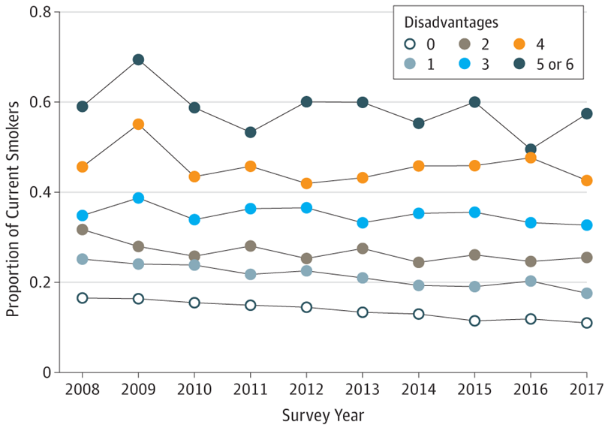
Examining Risk:
Poverty, other disadvantages tied to higher smoking risk
Source: Association of Cumulative Socioeconomic and Health-Related Disadvantage With Disparities in Smoking Prevalence in the United States, 2008 to 2017 (Leventhal, Bello, Galstyan, et al.)
About 14 percent of individuals without any of these forms of adversity smoked
With each added disadvantage, smoking rates increased, rising to 58 percent among individuals with all six forms of adversity
Unemployment/poverty
Low education
Disability
Serious psychological distress/heavy drinking
Notes:
(as the research shows) the more adversities an individual faces the more likely they are to start smoking and the less likely they are to quit.
In addition to the core exposure to trauma and trauma history there has been research around linkages to tobacco use/smoking around and six socioeconomic/health-related disadvantages:
Unemployment, Poverty, Low education, Disability, Serious psychological distress and Heavy drinking
14% without any of these disadvantages smoked BUT with each added disadvantage, smoking rates increased, rising to 58% among individuals with all 6 disadvantages.
Article: https://www.reuters.com/article/us-health-adversity-smoking-idUSKCN1S02I9

Slide 12
"Disadvantage is a common denominator in smoking in the U.S. today, and if you face more disadvantages, your liability to smoking increases.
Disparities in smoking are explained by disadvantaged populations being more likely to start smoking and less likely to quit smoking."
Source: Leventhal, 2019
Notes:
So the key here is Disadvantage is THE common denominator for smoking in the U.S. today
And if you face increasing disadvantages in your life, you are more likely to start smoking and less likely to quit.

Slide 13
Understanding Trauma: taking a closer look
Notes:
I just provided some overarching context to the impt of addressing TU among individuals with MH/SU C
I want to transition now into taking a closer look at one of the many reasons I said previously as to why individuals begin smoking (trauma & tobacco)…It’s not the only one but it is an impt one bc we don’t often think about trauma and tobacco together.

Slide 14

Adversity, Trauma and Toxic Stress
Trauma – possible outcome of exposure to adversity that occurs when a person perceives an event or set of circumstances as extremely frightening, harmful or threatening.
Toxic stress – can occur when an individual experiences adversity that is extreme, long-lasting and severe without adequate support and the stress response system becomes overactivated.
Childhood adversity – wide range of circumstances or events that pose a serious threat to a child’s physical or psychological well-being.
Adverse childhood experiences –a subset of childhood adversities included in the seminal ACEs study.
Child Trends, 2019.
Notes:
As many of you participating in today’s training may already have a good understanding of the terminology you see here, but want to ground in these basic definitions to ensure we are working from shared meaning.
Caution – take care of yourself in anyway that you need to
Trauma is one possible outcome of exposure to adversity. Trauma occurs when a person perceives an event or set of circumstances as extremely frightening, harmful, or threatening—either emotionally, physically, or both - and it has lasting adverse effects on the individual’s mental, physical, social, emotional, or spiritual well-being.”
With trauma, a child’s experience of strong negative emotions (e.g., terror or helplessness) and physiological symptoms (e.g., rapid heartbeat, bedwetting, stomach aches) may develop soon afterward and continue well beyond their initial exposure. Childhood trauma is associated with problems across multiple domains of development. However, trauma affects each child differently, depending on his or her individual, family, and environmental risk and protective factors.
Toxic stress can occur when an individual experiences adversity that is extreme, long-lasting, and severe (e.g., chronic neglect, domestic violence, severe economic hardship) without adequate support from a caregiving adult. These adversities can over-activate the stress response system, wearing down the body and brain over time, and changing our neurobiology.
Childhood adversity is a broad term that refers to a wide range of circumstances or events that pose a serious threat to a child’s physical or psychological well-being. Common examples of childhood adversity include child abuse and neglect, domestic violence, bullying, serious accidents or injuries, discrimination, extreme poverty, and community violence. Research shows that such experiences can have serious consequences, especially when they occur early in life, are chronic and/or severe, or accumulate over time.
Adverse childhood experiences (ACEs)—a term coined by researchers Vincent Felitti, Robert Anda, and their colleagues in their seminal study conducted from 1995 to 1997—are a subset of childhood adversities. And I am going to go into more in depth on this one later

Slide 15








Key Elements of Trauma
Events
Experiences
Effects
​
​
​
​
​
​
15
Notes:
Trauma has three key elements​
​
​
Individual trauma results from an event, or series of events or set of circumstances that is experienced directly or indirectly as overwhelming or life-changing, that has profound effects on the individual's well-being, psychological development or has physiological, social ​and/or spiritual impact. ​

Slide 16




Making Connections
Sources estimate that 25 -75% of abuse and/or violent trauma survivors develop alcohol misuse issues
Survivors of accidents, illness, or natural disasters have between 10 to 33% higher rates of addiction
A diagnosis of PTSD increases the risk of developing alcohol misuse
Male and female sexual abuse survivors experience a higher rate of addiction compared to those who have not survived such abuse
Source: The Correlation Between Trauma and Substance Abuse. (August 2021). The Recovery Village. https://www.palmerlakerecovery.com/blog/trauma-substance-abuse.
Notes:
We will talk more about some statistics and highlight the strong correlations between trauma and smoking in a moment, but we can sum it up by saying that trauma-leads to addictions and addictions lead to trauma.
There are physiological explanations for this, as outlined in books by Dr. Mate and others, and this connection is also related to the fact that people who have experienced trauma self sooth, as I noted, to address intolerable feelings and emotions, often related to fear. This numbing, or self-soothing leads to abuse of substances and addictions, and those who use abuse substances often put themselves in harms way, which leads to more trauma.

Slide 17
Trauma & Smoking in Behavioral Health Populations: The connection
Notes:
Alright, so you can tell I’ve started to get into the connection but let’s talk further about it.
I mentioned earlier that 1 in 4 adults have some form of mental health or substance use challenges and collectively they consume approx. 40% of all commercial cigarettes and there were several reasons individuals begin smoking (predatorial practices by tobacco industry thru marketing, blocking of smoke free policies, providing free & cheap cigarette to psychiatric facilities, etc) and high rates of trauma.
We just spent time grounding in a shared understanding of trauma, incl ACEs, and how it may impact the brain and the link it has to long term outcomes.
Now I want to dive deeper into the connection bw trauma and tobacco use bc this is something we don’t typically think about in 1) tobacco control efforts and 2) from a provider perspective- why it is just as critical to address TU in the individuals we are serving.

Slide 18
PTSD and DSM-5 Diagnostic Criteria
Exposure to actual or threatened death, serious injury or sexual violence
Intrusion symptoms
Persistent avoidance of stimuli associated with the trauma
Negative alterations in cognitions and mood that are associated with the traumatic event
Alterations in arousal and reactivity associated with the traumatic event
Persistence of symptoms (B, C, D and E) for more than one month
Significant symptom-related distress or functional impairment
Not due to medication, substance or another medical condition
Source: Substance Abuse and Mental Health Services Administration, 2014
Notes:
This may or may not be familiar to you but here are the diagnostic criteria for PTSD as given in the DSM-5. I won’t run down the entire list, but this gives you a sense of the depth and breadth of the disorder, and how it plays out depending on the individual. For point B, intrusion symptoms are typically characterized by distressing memories, dreams, and reactions to the trauma (flashbacks are a common example). Additionally, symptoms can be distinguished in certain categories, including depersonalization (feeling out of body/self) and derealization (experiencing a sense of unreality and dreamlike sensations).
Source for slide: https://www.ncbi.nlm.nih.gov/books/NBK207191/box/part1_ch3.box16/
Notes from Karen:
-Because of a variety of clinical phenotypes are consistent with PTSD diagnostic criteria, PTSD is no longer, as of DSM-5, considered an Anxiety Disorder
-Trauma- and Stressor-Related Disorders: PTSD, ASD, ADs, Reactive Attachment Disorder, etc
DSM-5: Changes to PTSD Criteria
Criterion A2 (response involves “fear, helplessness, or horror”) removed from DSM-5
3 clusters are divided into 4 clusters in DSM-5
3 new symptoms were added
Other symptoms revised to clarify symptom expression
All symptoms began or worsened after the trauma
Separate diagnostic criteria for “preschool” (children 6 years or younger)
New dissociative subtype for PTSD added
PTSD formally recognized in 1980 by the APA
We have made great strides in understanding ACES and connection between trauma and negative health outcomes
We have more understanding in traumatic responses, attachment which allows us to make connections between trauma physiology and adaptations, such as addition
We are just starting to see the relation between neuroscience and addiction
Posttraumatic stress disorder is a disorder of recovery, characterized by an inability to recover from a stress reaction to a traumatic event (Kessler et al., 1995). A failure to recover from symptomatic reactions to traumatic event exposure among a substantial minority of trauma-exposed individuals can be contrasted to the majority of trauma-exposed individuals who recover from exposure within the first few months post-exposure (Gilboa-Schechtman & Foa, 2001;Kilpatrick & Resnick, 1993). There are multiple ways to index the degree to which an individual fails to recover from traumatic event exposure, which is important to consider as studies of smoking–PTSD comorbidity have utilized various approaches to indexing the severity of posttraumatic reactions. One approach is to examine total symptom severity, which is typically calculated as a sum of frequency and intensity ratings of each of the Diagnostic and Statistical Manual – Fourth Edition – Text Revision (DSM-IV-TR; APA, 2000) defined symptoms of PTSD (Blake et al., 1995; Foa, 1995). A second approach is to examine symptom intensity within empirically supported types, or clusters, of PTSD symptoms (Lyons, Gerardi, Wolfe, & Keane, 1988). There are three specific clusters (APA, 2000): reexperiencing (e.g., intrusive thoughts, nightmares), avoidance (e.g., trying to not think about a traumatic event), and hyperarousal (e.g., easily startled) symptoms. Finally, failure to recover from exposure to a traumatic event also is frequently indexed via meeting diagnostic criteria for PTSD, which include the following: exposure to a traumatic event, which is followed by at least one reexperiencing symptom, three or more avoidance/numbing symptoms, two hyperarousal symptoms, and these symptoms have lasted for at least one month resulting in clinically-significant distress or impairment (APA, 2000)

Slide 19
Post-Traumatic Stress Disorder (PTSD)
  Anyone can develop it after witnessing and/or experiencing a traumatic event
  Affects about 3.5% of Americans at any given time (or about 11 million people)
  About 1 in 11 people will be diagnosed with PTSD in their lifetime
Source: What is Posttraumatic Stress Disorder(PTSD)? (2020). American Psychiatric Association. https://www.psychiatry.org/patients-families/ptsd/what-is-ptsd
Notes:
Transition to trauma in early adulthood/adulthood-
Post-Traumatic Stress Disorder (PTSD) is generally defined by the characterization that people develop it after exposure to a traumatic event, such as (but not limited to) a natural disaster, war/combat, physical and sexual assault, abuse, acts of violence, car accidents. PTSD affects about 3.5% of US adults at any given time (or about 11 million people). Symptoms be short-term, lasting a month after a single event for example, but can also persist for months or years. Additionally, the disorder can recede and reappear at a later time, or not surface until months or years after the trauma exposure. So we know that the duration and severity of PTSD lies on a spectrum, but generally, about 1 in every 11 people will receive a PTSD diagnosis in their lifetime.
Source: APA (https://www.psychiatry.org/patients-families/ptsd/what-is-ptsd)

Slide 20
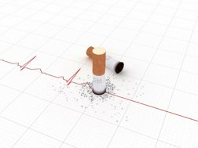
Health Risk Behaviors Long Term Health Consequences
Individuals with a history of severe trauma ​
are twice as likely to develop a smoking​
dependence​
45% of adults with a PTSD diagnosis​ smoke​
73% of those smoke 1+ pack of cigarettes​ per day
​
Sources: Lasser et al, 2000; Buckley et al, 2004
Notes:
Now that we’ve set the groundwork for how PTSD is formed and how it presents itself, we might ask ourselves, where does tobacco come in? These are a few introductory statistics on what we already know about the link between trauma and tobacco. Multiple studies have shown that individuals with a post-traumatic stress disorder (PTSD) diagnosis are twice as likely to smoke. Another body of research has shown that it can go both ways, in that smokers are also approximately twice as likely to have PTSD than nonsmokers. Additionally, 45% of adults with PTSD smoke. When considering outcomes over the lifespan, we know that about 2/3 of people with a lifetime PTSD diagnosis (long term) also reported a lifetime history of smoking. We have some research that also indicates about 73% of people who smoke and have a PTSD diagnosis are relatively heavy smokers, smoking at least one pack of cigarettes per day.
So we can say with a good deal of confidence that these statistics show at least a correlation between tobacco use and the presence of PTSD.
Sources:
-https://www.ncbi.nlm.nih.gov/pubmed/30192425
-https://www.ncbi.nlm.nih.gov/pmc/articles/PMC2575106/
Subsequent studies have since found ranges from 38-87% and most recent in 2018 (27-40%); Lasser's study was the first and groundbreaking in understanding smoking among adults with PTSD- consistenly high rates of smoking among adults with PTSD
Reports of trauma exposure in early adulthood were associated with up to a two-fold increased risk of smoking (Roberts, Fuemmeler, McClernon, & Beckham, 2008).​
Individuals who have been exposed to trauma and develop a full diagnosis of PTSD smoke more intensely. ​
Evidence has shown that experiencing child abuse is associated with more severe nicotine withdrawal and nicotine dependence suggesting that some ACEs make tobacco cessation more difficult (Smith, Hoish, Saddleson et al., 2001)
So just generally we know that in addition to ( slide stats) : ​
Adverse childhood experiences (ACEs) have been linked to increased use of tobacco products in adolescent and in adults (Alaca et al 2016) ​
Primary prevention of adverse childhood experiences and improved treatment of exposed children could reduce smoking among both adolescents and adults (Anda 1999)​
The strengths of the relationships between each of the categories of ACEs and smoking initiation and current smoking behavior were comparable although there are some difference in the types of ACES and results. However the main ACES study, and subsequent smaller studies have found that ALL categories of adverse childhood experiences were also significantly associated with ever smoking and heavy smoking ​
​
So although we see as association with all some studies show that not all ACEs affect smoking risk the same​
For example, a past event of child abuse is associated with more severe nicotine withdrawal and nicotine dependence which suggests some ACEs make it harder to cease tobacco use, or more severe and prolonged trauma might be associated with earlier initiation and heavier use(Smith, Saddleson, Kozlowski, & Giovino, 2013). ​
​
And a few smaller studies found that the relationship between the frequency of exposure to emotional abuse, physical abuse, and maternal battery and early smoking initiation and current smoking using the least severe forms of abuse or violence show a positive relationship between the frequency of exposure to these forms of violence and the prevalence of smoking behaviors. ​
Additional smaller studies have show even greater associations around sexual abuse (abuse that occurred by 14 years of age or younger) such as the prevalence of early smoking initiation being 25.1% for persons who had been sexually abused and 8.7% for those who had not (adjusted OR, 3.9; 95% CI, 3.2-4.7); the prevalence of current smoking for those respondents who had been sexually abused was 14.4% and 8.2% for those who had not (adjusted OR, 2.7; 95% CI, 2.2-3.3).​
Higher ACEs scores correlate to higher risk of smoking (dose-response relationship)​
Young adults with high/multiple ACEs scores reported more alcohol-related problems, current tobacco use, and psychological symptoms (Shin, McDonald, & Conley 2018)​
ACEs play a role in both smoking initiation and maintenance of smoking behavior in the presence of illness and poor health ​
​
​
Associations Between Adverse Childhood Experiences and Smoking Behaviors https://jamanetwork.com/journals/jama/fullarticle/192056 ​
​

Slide 21
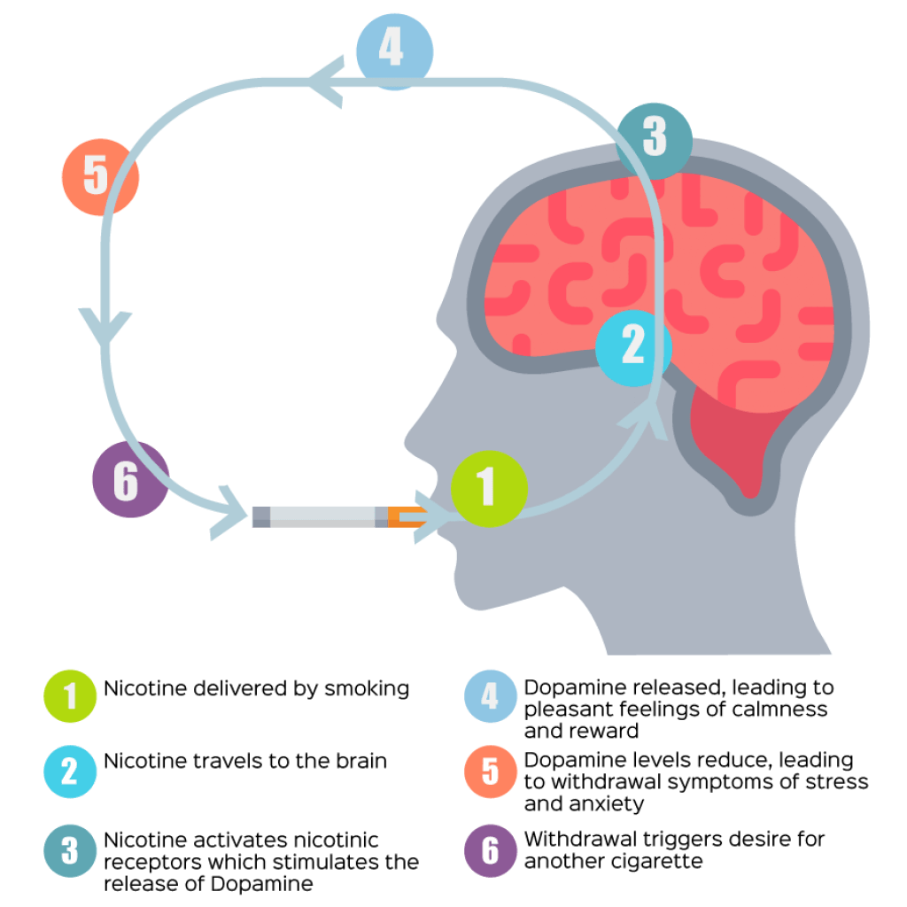
The relationship between smoking and PTSD is bi-directional.
Smoking possesses three unique factors that make it a reinforcer for at-risk individuals. Due to this effect, individuals with PTSD trying to quit may frequently relapse.
1. Pleasure/positive affect
2. Anxiety reduction (Kassel & Unrod, 2000)
3. Distress termination (Kassel, Stroud & Paronis, 2003)
Image Source: Action on Smoking and Health Wales Cymru
Notes:
When any substance is used, incl tobacco, nicotine is carried into the lungs via smoke particles where it is absorbed into blood and makes its way quickly to the brain. Once in the brain, nicotine increases the release of dopamine, a chemical that signals pleasure. ​
The relationship between smoking and PTSD is bi-directional.
Smoking possesses three unique factors that make it a reinforcer for at-risk individuals. Due to this effect, individuals with PTSD, trying to quit may frequently relapse.
Pleasure/positive affect (Strong et al. 2011)
Perceptions around Anxiety reduction, (Kassel & Unrod, 2000)
Distress termination re: withdrawal (Kassel, Stroud & Paronis, 2003)
​ And this is true of any kind of substance use, not just tobacco
Increases in tobacco use heightens risk of emotional disorder symptoms such as those found in PTSD
Sustained abstinence of smoking decreases emotional symptoms
Sources:
Strong, D. R., Leventhal, A. M., Evatt, D. P., Haber, S., Greenberg, B. D., Abrams, D., & Niaura, R., 2011 (Positive reactions to tobacco predict relapse after cessation. - PsycNET (apa.org))
Kassel & Unrod, 2000 (Smoking, anxiety, and attention: Support for the role of nicotine in attentionally mediated anxiolysis. - PsycNET (apa.org)
Kassel, Stroud & Patronis, 2003 (Smoking, stress, and negative affect: Correlation, causation, and context across stages of smoking. - PsycNET (apa.org)

Slide 22
Symptomology
People with a PTSD diagnosis who smoke are more likely to:
  Experience exacerbated symptoms of PTSD, including depression and anxiety (Chou et al., 2018)
  Have a higher trauma history, a negative affect, and a greater comorbid psychiatric history (Kearns et al., 2018)
  Endure escalating negative psychological symptoms, such as emotional reactivity and startle responses (Chou et al., 2018)
Notes:
It is clear that PTSD-smoking comorbidity is common, it is less clear which disorder emerges first
Sources:
Chia-Ying Chou, Ellen Herbst, Marylene Cloitre & Janice Y. Tsoh | Graziano Pinna (Reviewing editor) (2018) An emotion regulation-focused theoretical framework for co-occurring nicotine addiction and PTSD: Comments on existing treatments and future directions, Cogent Medicine, 5:1, https://doi.org/10.1080/2331205X.2018.1558731
Kearns, N. T., Carl, E., Stein, A. T., Vujanovic, A. A., Zvolensky, M. J., Smits, J., & Powers, M. B. (2018). Posttraumatic stress disorder and cigarette smoking: A systematic review. Depression and anxiety, 35(11), 1056–1072. https://doi.org/10.1002/da.22828

Slide 23
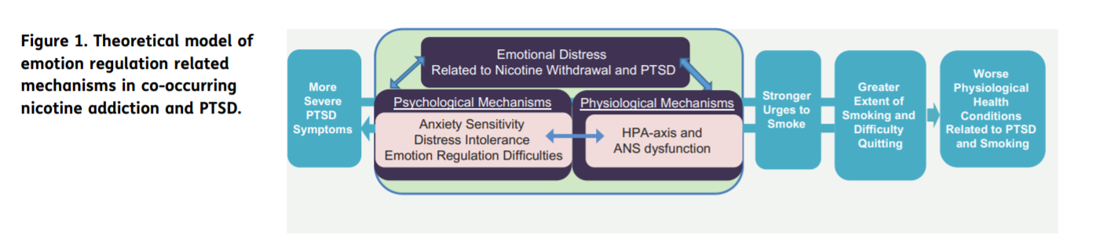
Symptomology
Reduction of negative affect is the most consistently identified smoking motive among individuals with PTSD (Kearns et al., 2018)
Using tobacco can worsen physical symptoms of PTSD, including cardiovascular diseases and premature death (Dennis et al., 2014)
Image Source: Chou et al., 2018 (Full article: An emotion regulation-focused theoretical framework for co-occurring nicotine addiction and PTSD: Comments on existing treatments and future directions (tandfonline.com)
23
Notes:
Individuals with a PTSD diagnosis can harbor expectations that smoking will reduce severity of negative affect, so they increase their rate of smoking as an attempt to regulate their emotions
Smokers with PTSD tend to smoke in response to stress or PTSD symptoms
What's less discussed is that patients often don't realize they might have PTSD and try to relieve symptoms by self-medicating with alcohol, tobacco and other substance use — worsening habits that existed before the trauma or starting anew.
Definitions –
HPA axis: the interaction between the hypothalamus, pituitary gland, and adrenal glands; it plays an important role in the stress response.
ANS: Autonomic nervous system is the part of the nervous system that controls and regulates the internal organs. A dysfunction of the nerves that regulate nonvoluntary body functions, such as heart rate, blood pressure, and sweating.
Sources:
Kearns, N. T., Carl, E., Stein, A. T., Vujanovic, A. A., Zvolensky, M. J., Smits, J., & Powers, M. B. (2018). Posttraumatic stress disorder and cigarette smoking: A systematic review. Depression and anxiety, 35(11), 1056–1072. https://doi.org/10.1002/da.22828
Dennis, P. A., Watkins, L. L., Calhoun, P. S., Oddone, A., Sherwood, A., Dennis, M. F., … Beckham, J. C. (2014). Posttraumatic stress, heart rate variability, and the mediating role of behavioral health risks. Psychosomatic Medicine, 76, 629–637. https://doi.org/10.1097/psy.0000000000000110
Chia-Ying Chou, Ellen Herbst, Marylene Cloitre & Janice Y. Tsoh | Graziano Pinna (Reviewing editor) (2018) An emotion regulation-focused theoretical framework for co-occurring nicotine addiction and PTSD: Comments on existing treatments and future directions, Cogent Medicine, 5:1, https://doi.org/10.1080/2331205X.2018.1558731

Slide 24
Special Populations
Nearly 20 percent of returning veterans from Iraq and Afghanistan (or 300,000 people) have symptoms of PTSD or major depression
(Tanielian and Jaycox, 2008).
Among a sample of military veterans, 47% of smokers screened positive for PTSD, compared to 33% of the nonsmokers in the sample
6 out of 10 veterans with PTSD smoke
Females who have experienced traumatic event(s) are more likely to smoke if they become pregnant
  Females who are pregnant and smoke have 10% higher rates of current and lifetime PTSD than females who quit smoking while pregnant (Kornfield et al., 2017)
Source: Substance Abuse in Veterans - PTSD: National Center for PTSD (va.gov)
Notes:
So we could spend an entire additional webinar discussing the populations that are particularly impacted by PTSD, but given our time constraints, we will briefly touch on populations of special consideration with PTSD and/or smoking, with the caveat that this is by no means an exhaustive list.
A group of people that the public commonly associates with PTSD are veterans. You can see here that 20% or about 1 in 5 returning vets present symptoms of PTSD or major depression. The number of veterans who smoke nicotine is almost double for those with PTSD (about 6 of 10 people) versus those without a PTSD diagnosis (3 of 10 people). Another study shows that trauma exposure that results in fear, helplessness, or horror (FHH), as well as current PTSD symptom severity and probable PTSD diagnosis was a significant predictor of smoking during pregnancy. Pregnant smokers also had higher rates of current (21 vs. 11%) and lifetime PTSD (38 vs. 28%) than females who quit smoking during pregnancy. So the takeway here is that probable links between PTSD and smoking have been discovered in very different populations in very different contexts.
-Returning veterans from Iraq and Afghanistan seem vulnerable.
- The number of Veterans who smoke (nicotine) is almost double for those with PTSD (about 6 of 10) versus those without a PTSD diagnosis (3 of 10)
-Trauma exposure that resulted in fear, helplessness, or horror (FHH), as well as current PTSD symptom severity and probable PTSD diagnosis showed statistical significance as predictors of smoking during pregnancy
Sources:
Lisa H. Jaycox, 2008 (ADA482583.pdf (dtic.mil))
Substance Abuse in Veterans - PTSD: National Center for PTSD (va.gov)
Kornfield, S. L., Moseley, M., Appleby, D., McMickens, C. L., Sammel, M. D., & Epperson, C. N. (2017). Posttraumatic Symptom Reporting and Reported Cigarette Smoking During Pregnancy. Journal of women's health (2002), 26(6), 662–669. https://doi.org/10.1089/jwh.2016.5928

Slide 25
Cessation in Special Populations
Individuals with a PTSD diagnosis experience less successful quit attempts than people without mental health conditions (Kelly, Jensen, & Sofuoglu, 2015)
  Treatment failure is often directly related to PTSD symptoms
Rates of smoking abstinence for 30 days or more among people with a PTSD diagnosis are 50% lower than the rate among adults who use tobacco and do not have a psychiatric diagnosis (Kearns et al., 2018)
Notes:
So what does cessation look like in people who have PTSD? Generally, quit attempts are less successful in this group over time, and PTSD symptoms do play a role in cessation efforts - commonly, in the form of using smoking as an emotional numbing tool to quell severity of symptoms described earlier. That taken into account, it’s been found that rates of 1-month or more of smoking abstinence are essentially halved when considering folks with a PTSD diagnosis trying to quit.
At this point, I know we’ve covered a lot of information
Sources:
Kelly, M. M., Jensen, K. P., & Sofuoglu, M. (2015). Co-occurring tobacco use and posttraumatic stress disorder: Smoking cessation treatment implications. The American journal on addictions, 24(8), 695–704. https://doi.org/10.1111/ajad.12304
Kearns, N. T., Carl, E., Stein, A. T., Vujanovic, A. A., Zvolensky, M. J., Smits, J., & Powers, M. B. (2018). Posttraumatic stress disorder and cigarette smoking: A systematic review. Depression and anxiety, 35(11), 1056–1072. https://doi.org/10.1002/da.22828

Slide 26

Douglas W. Lane, PhD, ABPP, CPsychol
Dr Lane is geropsychologist in the Geriatrics and Extended Care Service of the VA Puget Sound Healthcare System. He is also a Clinical Professor in the Department of Psychiatry and Behavioral Sciences of the University of Washington School of Medicine and a Faculty Fellow in the School of Nursing of Pacific Lutheran University. He completed a PhD in Clinical Psychology through the University of Kansas, internship training in the United States Army Medical Department, and a fellowship in psychology through the Yale University School of Medicine. He has also completed post-graduate training in Health Professions Education through the University of Glasgow School of Medicine, Scotland. He is board-certified in Geropsychology and Clinical Psychology by the American Board of Professional Psychology (ABPP).

Slide 27
By the Numbers
According to the CDC , older people have the highest percentage of people who smoke.
About 18% of people between the ages of 45 and 64 smoke (the highest of all age groups).
Around 9 % of people between 65 years old and older smoke.
Approximately 70 % of all deaths related to smoking occur in people over 60 years old.
In sum: millions of people across all ages smoke, but it is primarily older people who suffer the consequences.
According to the VA, Veterans who have PTSD are more likely to smoke than those who do not. Co-morbidity rates are high.
People with mental illnesses have a harder time quitting.
Especially in the context of PTSD, reduced ability to tolerate stress can make quitting harder.
Sources: aginginplace.org/how-smoking-can-affect-the-elderly (22 JUL 22) Pericot-Valverdea, Elliott, Millerd, Tideyd, & Gaalemaa (2018) Addict Behav.
Notes:
This begins Dr. Lanes slides (placed in the order sent)

Slide 28
PTSD Symptom Categories
Intrusive memories
Avoidance
Negative changes in thinking and mood
Changes in physical and emotional reactions

Slide 29
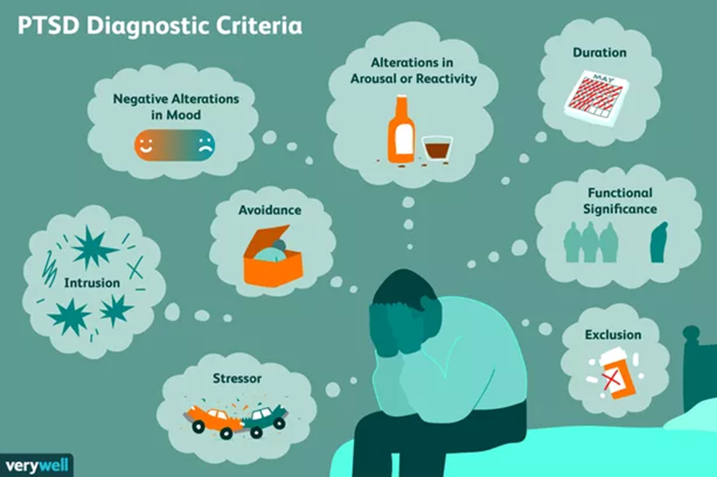
Proposed Role of Smoking in PTSD
Self Medication Hypothesis: Mitigate PTSD symptoms
  Negative emotional states
  Anxiety sensitivity
  Reduced stress tolerance
  Distraction from intrusive thoughts and memories
Reciprocal Relationship: Attempts at mitigation of Symptoms -> Increase in Symptoms ->Further efforts to mitigate, and so on
Source: verywellmind.com (22 JUL 22) J.R.Bee
Source: Pericot-Valverdea, Elliott, Millerd, Tideyd, & Gaalemaa (2018) Addict Behav.

Slide 30
Challenges for Older Smokers
Smoking can mean different things based on many factors of diversity. Age is just one. The intersectionality can be complex and can be missed without taking a patient-centered approach. It can be an important asset in cessation that is lost.
May have been smoking 20, 30, 40 years or more before deciding to stop
A belief that the damage is done, “What’s the point now?”
Past failed efforts to stop
Many other health issues to navigate
New relationship with time
Shame and stigma
Nature of the “relationship” with the substance, which may be quite positive to the person
Medical comorbidities such that medication intervention may be limited

Slide 31
Interventions
Education about the role of nicotine/smoking in their overall health status and addressing myths
-EX: Nicotine makes it even harder to sleep than chronic pain already does.
Education about the role of smoking (like drinking, eating, etc.) in facilitating avoidance and/or paradoxically increasing or complicating PTSD symptoms
General stress management/coping skills training (ACT, CBT)
Acute self calming/soothing training
Developing strong, healthy social support networks
Harm Reduction
  -Vaping
  -Low nicotine cigarettes
    -Just the act of smoking has calming effects, independent of nicotine, and lower nicotine leads to reduced somatic carousal (breaks the cycle).
Source:Pericot-Valverdea, Elliott, Millerd, Tideyd, & Gaalemaa (2018) Addict Behav.Ha Bui (2020) Subst Abuse & Misuse

Slide 32
Clinical Tip #1
Honor the person’s history with smoking.
If we take a disrespectful or youth-centric stance, we may defeat our own goal.
Be aware that society’s views have changed within the person’s lifetime.
The person may feel “double-crossed” by the medical field and larger society.
Don’t push: They have been doing this for a long time.
“I got through Korea with my M-1 rifle and a pack of Lucky Strikes.”
“Back then, if you didn’t smoke you were considered a sissy”.

Slide 33
Clinical Tip #2
In older age, we tend to become less focused on long term outcomes and more focused on immediate term outcomes. So, emphasize the benefits for chronic medical issues in the current term.
Have the person think through ways day-to-day life could be better, based on individual interests and values, by quitting.
        -Be Concrete and Specific
  -Ex: More money available to do other things (especially on a fixed income).
  -Make a list
  -Share it with important others or even have them help create It
Some benefits may be less obvious but just as important to highlight.
Ex: Cough Less -> Reduced Jarring and Muscular Exertion -> Reduced Back Pain
Older adulthood can bring an increased emphasis on relationships, so have important others share how their relationship with the person may benefit.
  Ex: “Dad, we can spend more time together because you are breathing better and have more energy.”
  Ex: Setting a good Example for grandchildren, “I love you enough to take care of myself and be with you as long as I can be.”
  Ex: Honor the health of those the person loves

Slide 34
Clinical Tip #3
Use the same materials, programs, and strategies as used for younger people.
But . . .
Use a Slower Pace.
Cover One Topic at A Time.
Use Regular Breaks.
Stop After Each Topic to Check Understanding.
Use Concrete, Clear language.
Use Written or Recorded Materials to Augment.
Accommodate for Hearing, Visual, or Other Physical Limits.
  Ex: A person with COPD may not be able to use relaxation breathing as an alternate stress management strategy (vs. smoking).

Slide 35
Clinical Tip #4
Relapses are an opportunity for learning. We are never “too old”.
The person has many years of coping with challenges by this point in life. This experience can help inform cessation treatment.
  *This is especially important for those whose alternate coping options are limited by physical, environmental, or financial factors.
If we don’t really believe the person can quit, then that can be detected by the person (“Stereotype Threat”; Ageism).
    * It is important to reflect on our own beliefs and stereotypes of aging, including our own aging.

Slide 36
Resources
“SmokeFree60+” (mobile app); National Cancer Institute
www.60plus.smokefree.gov
National Institute on Aging: Quitting Smoking for Older Adults
Quit Lines:
  877-448-7848 (National Cancer Institute)
  800-784-8669 (Smokefree.gov)
  855-784-8838 (VA Quit Line)

Slide 37
Sources
Apollonio, D, Malone, RE. Marketing to the marginalized: Tobacco industry targeting of the homeless and mentally ill. Tob Control, 2005;14(6):409–15.
Jamal A, Phillips E, Gentzke AS, et al 2016. Current Cigarette Smoking Among Adults. MMWR Morb Mortal Wkly Rep 2018;67:53–59.
Leventhal AM, Bello MS, Galstyan E, Higgins ST, Barrington-Trimis JL. Association of Cumulative Socioeconomic and Health-Related Disadvantage With Disparities in Smoking Prevalence in the United States, 2008 to 2017. JAMA Intern Med. 2019;179(6):777–785.
Kearns, N. T., Carl, E., Stein, A. T., Vujanovic, A. A., Zvolensky, M. J., Smits, J., & Powers, M. B. (2018). Posttraumatic stress disorder and cigarette smoking: A systematic review. Depression and anxiety, 35(11), 1056–1072.
Lasser K, Boyd JW, Woolhandler S, Himmelstein DU, McCormick D, & Bor DH (2000). Smoking and mental illness: A population-based prevalence study. Journal of the American Medical Association, 284(20), 2606–2610.
Buckley TC, Susannah ML, Bedard MA, Dewulf AC, Greif J. Preventive health behaviors, health-risk behaviors, physical morbidity, and health-related role functioning impairment in veterans with PTSD. Military Medicine. 2004;169:536–540.
Center for Substance Abuse Treatment (US). Trauma-Informed Care in Behavioral Health Services. Rockville (MD): Substance Abuse and Mental Health Services Administration (US); 2014. (Treatment Improvement Protocol (TIP) Series, No. 57.) Exhibit 1.3-4, DSM-5 Diagnostic Criteria for PTSD. Available from: https://www.ncbi.nlm.nih.gov/books/NBK207191/box/part1_ch3.box16/
Kassel, J. D., & Unrod, M. (2000). Smoking, anxiety, and attention: Support for the role of nicotine in attentionally mediated anxiolysis. Journal of Abnormal Psychology, 109(1), 161–166.
Kassel JD, Stroud LR, Paronis CA. Smoking, stress, and negative affect: correlation, causation, and context across stages of smoking. Psychol Bull. 2003 Mar;129(2):270-304.
Chia-Ying Chou, Ellen Herbst, Marylene Cloitre & Janice Y. Tsoh | Graziano Pinna (Reviewing editor) (2018) An emotion regulation-focused theoretical framework for co-occurring nicotine addiction and PTSD: Comments on existing treatments and future directions, Cogent Medicine, 5:1.
Kearns, N. T., Carl, E., Stein, A. T., Vujanovic, A. A., Zvolensky, M. J., Smits, J., & Powers, M. B. (2018). Posttraumatic stress disorder and cigarette smoking: A systematic review. Depression and anxiety, 35(11), 1056–1072.
Dennis PA, Watkins L, Calhoun PS, et al. (2014). Posttraumatic stress, heart-rate variability, and the mediating role of behavioral health risks. Psychosomatic Medicine, 76(8), 629–637.
Tanielian T, Jaycox LH, editors. Invisible Wounds of War: Psychological and Cognitive Injuries, Their Consequences, and Services to Assist Recovery. Santa Monica, California: RAND Corporation; 2008.
Kornfield SL, Moseley M, Appleby D, McMickens CL, Sammel MD, Epperson CN. Posttraumatic Symptom Reporting and Reported Cigarette Smoking During Pregnancy. J Womens Health (Larchmt). 2017 Jun;26(6):662-669.
Kelly, M. M., Jensen, K. P., & Sofuoglu, M. (2015). Co-occurring tobacco use and posttraumatic stress disorder: Smoking cessation treatment implications. The American journal on addictions, 24(8), 695–704. https://doi.org/10.1111/ajad.12304

Slide 38

Comments & Questions?
Questions?

Slide 39

Thank You for Joining Us!
Visit Bhthechange.org and Become a FREE Member Today!
Contact Information:
Tamanna Patel
tamannap@thenationalcouncil.org

